Slide 1
Data Mining
BY
Adnan Amin

Slide 2

Frequent Pattern Mining

Slide 3
Frequent patterns
Patterns:
Item sets, subsequences, substructures)
Frequent patterns:
Patterns that appear frequently in a dataset.
Definition:
It searches for repeated relationships in a given dataset.
Frequent itemset mining leads to the discovery of associations and correlations among items in large transactional or relational datasets.

Slide 4
Advantages of mining frequent patterns?
It helps in:
Data classification
Associations rules mining
Clustering and other mining tasks.
For example:
Frequent item sets: A set of items, such as milk and bread, that appear frequently together in a transaction dataset.
Frequent subsequences: first buying PC, then Webcam, and then a memory stick, if it occurs frequently in a shopping dataset, is a frequent sequential pattern.
Frequent substructures: if a sub-graphs, sub-trees occurs frequently in a dataset.

Slide 5
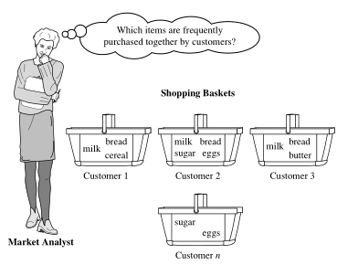
Motivation by Example
Market Basket Analysis (MBA):
MBA is a data mining process in which analyzes customer buying habits by finding associations between different items that customers place in their “shopping baskets”.

Slide 6
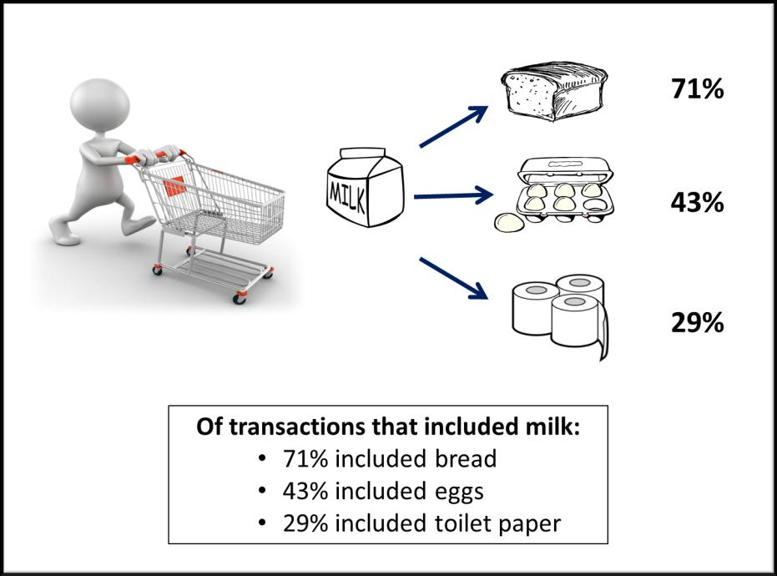
Market basket analysis cont.
If customers are buying milk, how likely are they to also buy bread (and what kind of bread) on the same trip?

Slide 7
Association Rules mining
Finding frequent patterns, associations, correlations, or usual structures among sets of items in transaction dataset.
For example:
Mining the customer buying habits by:
Finding associations and correlations between the different items that customers places in their “shopping basket”.
Application of Association rules mining:
Market basket analysis, catalog design, fraud detection

Slide 8

Association Rules Mining
IF-THEN relationship.
There are two elements of these rules:
Antecedent (IF): This is an item/group of items that are typically found in the Itemsets or Datasets.
Consequent (THEN): This comes along as an item with an Antecedent/group of Antecedents.
Antecedent (X) → Consequent (Y)

Slide 9
Measure association between Itemsets.
measures of rule interestingness.
Support
Confidence
Lift

Slide 10

1. Support
It gives the fraction of transactions which contains item A and B. Basically Support tells us about the frequently bought items or the combination of items bought frequently.
So with this, we can filter out the items that have a low frequency.

Slide 11


2. Confidence
It tells us how often the items A and B occur together, given the number times A occurs.

Slide 12

3. Lift
Lift indicates the strength of a rule over the random occurrence of A and B. It basically tells us the strength of any rule.
Let’s say for A -> B, the lift value is 4. It means that if you buy A the chances of buying B is 4 times. Let’s get started with the Apriori Algorithm now and see how it works.

Slide 13
HINTS
Association rules are considered interesting if they satisfy both:
A minimum support threshold (min_sup)
A minimum confidence threshold (min_conf)
These threshold can be set by users or domain experts.
Rules that satisfy both a min_sup and min_conf are called strong rule. Usually write in between 0%-100% values.
What is support and confidence?

Slide 14
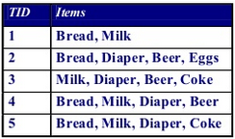
Support count (∂)
It is the frequency of occurrence of an itemset.
The occurrence frequency of an itemset is the number of transactions that contain the itemset, refer count of interest or frequency or support count.
E.g., ∂({Milk, Bread, Diaper}) = 2
s({Milk,Bread,Diaper}) = 2/5
Itemset{Milk, Bread, Diaper}

Slide 15
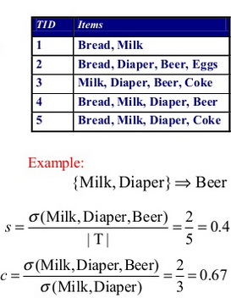
Example: 1

Slide 16
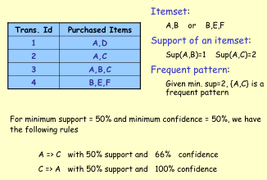
Example 2

Slide 17
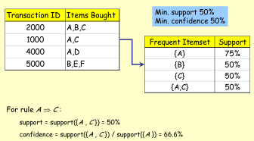
Example 3

Slide 18
Methods for Association rules mining
To Extract information on purchasing behavior
"IF buys coke and burger, THEN also buys ketchup with high probability“
Use various methods such as:
Apriori algorithm
FP Growth algorithm

Slide 19
Apriori Algorithm
It is based on the concept that a subset of a frequent itemset must also be a frequent itemset.

Slide 20
Apriori Algorithm
Proposed by R. Agrawal and R. Srikant in 1994 for mining frequent itemsets.
The name of algorithm is based on the fact that the algorithm uses prior knowledge.
Apriori algorithm finds frequent itemsets (with minimum support).
If min_sup is high then few frequent itemsets and few valid rules which occurs very often.
If min_sup is low then many valid rules which occur rarely.

Slide 21
Apriori Algorithm cont.
It consists of two steps:
Generation of candidate itemsets
Pruning (Removing) of itemsets which are infrequent
To improve the performance of Apriori algorithm.
All nonempty subsets of a frequent itemset must also be frequent. (apriori property)
If a set cannot pass a test, all of its supersets will fail the same test as well. (antimonotonicity)

Slide 22
Apriori Algorithm (Finding Frequent itemsets)
It has an iterative approach known as a level-wise search.
Steps:
The set of frequent 1-itemsets is found (called L1)
L1 is used to find frequent 2-itemsets (L2)
L2 is used to find L3, and so on…
Until no more frequent k-itemsets can be found.
Issue:
The finding of each Lk requires one full scan of the database.

Slide 23
Procedure
Step 1:
The algorithm simply scans all of the transactions to count the number of occurrences of each item.
Step 2:
Set the minimum support count (let it is min_sup=2)
The set of frequent 1-itemsets, L1, can then be determined. It consists of the candidate 1-itemsets satisfying min_sup in C1.
Step 3:
To discover the set of frequent 2-itemsets, L2, the algorithm uses the join L1*L1 to generate a candidate set of 2-itemsets, C2. and removed candidate if not satisfy min_sup.
Step 4: repeat until no more frequent itemset

Slide 24
Apriori Algorithm: Example
Finding frequent itemsets level wise
Search Space of Database D
Level 4
12345
Level 3
1234 1235 1245 1345 2345
123 124 125 134 135 145 234 235 245 345
Level 2
Level 1
12 13 14 15 23 24 25 34 35 45
Level 0
1 2 3 4 5

Slide 25
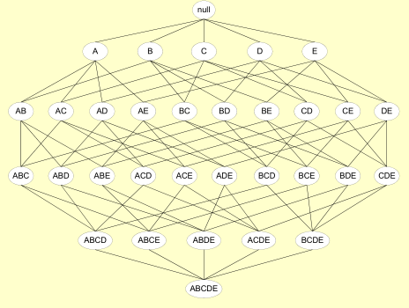
Another Example: Find pruned supersets

Slide 26
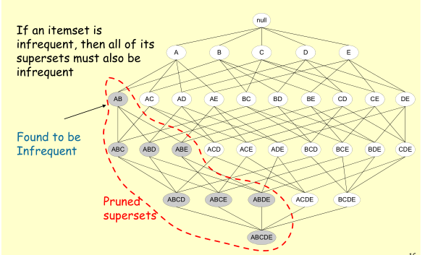
Apriori Principal for Pruning candidate

Slide 27
Apriori Algorithm: Example
Generating Candidates
L3={abc, abd, acd, ace, bcd}
Self-joining: L3 * L3 (let min_sup=2)
abcd from abc and abd
acde from acd and ace
Pruning:
acde is removed because adeis not in L3
We get:
C4={abcd}

Slide 28
Apriori Algorithm: Dry Run Example 1
Database D
L₁
C₁
Scan D
C₂
C₂
L₂
Scan D
C₃
Scan D
L₃

Slide 29
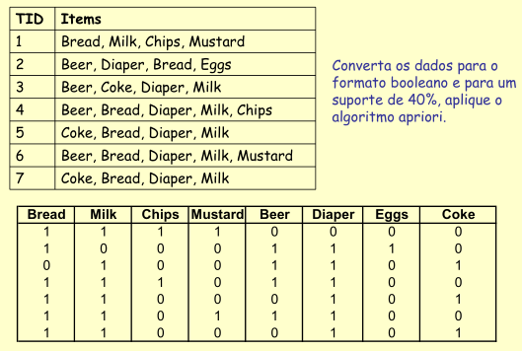
Example 2
Convert the dataset into boolean
Format where support is 40%
Using Apriori algorithm

Slide 30
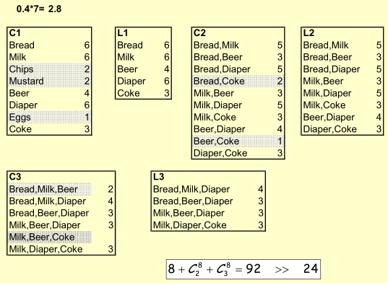
Example 2 cont.

Slide 31
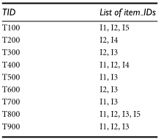
Apriori Algorithm: Dry Run Example 3
Transaction data:

Slide 32
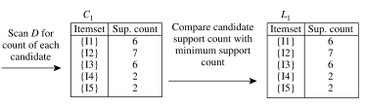
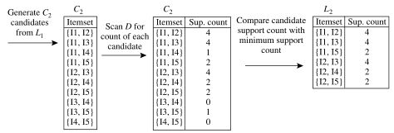

{{I1, I2, I3}, {I1, I2, I5}, {I1, I3, I5}, {I2, I3, I4}, {I2, I3, I5}, {I2, I4, I5}}.

Slide 33
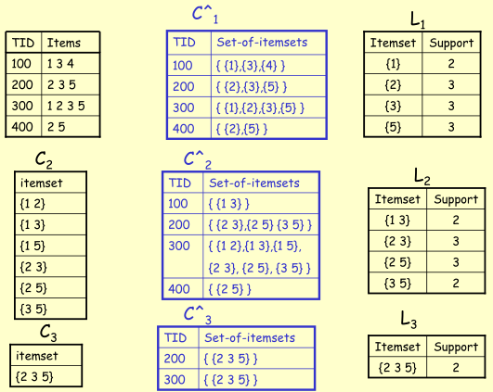
Example 4

Slide 34

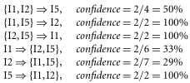
Association Rules generations
Once the frequent itemsets from transaction database D have been found then easily generate association rules from them.
Let X= {i1, i2, i5} is frequent itemset from
Nonempty subsets of X are
{i1,i2},{i1,i5},{i2,I,5},{i1},{i2}, {i5}
What are the association rules from X?
If the min_conf=70% then only
2nd, 3rd and 6th rules are output.

Slide 35
FP Growth Algorithm
Frequent Pattern Growth

Slide 36
FP Growth Algorithm
Apriori: uses a generate-and-test approach
Generates candidate itemsets and tests if they are frequent.
Generation of candidate itemsets is expensive (in both space and time)
Support counting is expensive (subset checking, multiple database scans)
FP-Growth: allows frequent itemset discovery without candidate itemset generation.
Two step approach:
Step 1: Build a compact data structure called the FP-tree.
Step 2: Extracts frequent itemsets directly from the FP-tree.

Slide 37
Step 1: FP-Tree Construction
Scan database for frequent 1-itemsets and place resulting set in a list L in descending order by frequency (support).
Now construct an FP-Tree as:
Create a root node and labeled NULL
Scan database
Process the items in each transaction in L order
From the root, add nodes in the order in which items appear in the transactions.
Link nodes representing items along different branches.

Slide 38
Step 1: FP-Tree Construction cont.
Database D={(I1,I2,I5),(I2,I4),(I2,I3,I6),(I1,I2,I4),(I1,I3),(I2,I3), (I1,I3),(I1,I2,I3,I5),(I1,I2,I3)}
Minimum support of ~20% (count of 2)
Frequent 1-itemsets
I1, I2, I3, I4, I5
Construct list (item, support count)
L = {(I2,7),(I1,6),(I3,6),(I4,2),(I5,2)}
TID | Items
1 | I1,I2,I5
2 | I2,I4
3 | I2,I3,I6
4 | I1,I2,I4
5 | I1,I3
6 | I2,I3
7 | I1,I3
8 | I1,I2,I3,I5
9 | I1,I2,I3
items | sup
I2 | 7
I1 | 6
I3 | 6
I4 | 2
I5 | 2

Slide 39
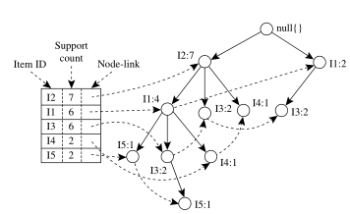
FP-tree, Frequent Pattern information
TID | Items
1 | I1,I2,I5
2 | I2,I4
3 | I2,I3,I6
4 | I1,I2,I4
5 | I1,I3
6 | I2,I3
7 | I1,I3
8 | I1,I2,I3,I5
9 | I1,I2,I3

Slide 40
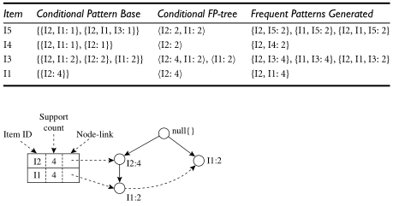

Slide 41
Pattern Evaluation Methods
Based on support-confidence thresholds, we exclude the good number of uninteresting rules.
Strong rules are not always necessarily interesting.
How can we find which strong association rules are really interesting?
Need to move from association analysis to correlation analysis.
Association analysis for:
A=>B [support, confidence]
Correlation analysis for:
A=>B [support, confidence, correlation]

Slide 42

1. Lift
Simple correlation measure.
The occurrence of itemset A is independent of the occurrence of itemset B
If P(AUB) = P(A)P(B)
Else itemsets A and B are dependent and correlated as events.
The lift between the occurrence of A and B can be measured by computing:
The resulting value can be <1 or >1 or equal 1.

Slide 43
1. Lift cont.
If the resulting value < 1 then occurrence of A negatively correlated with occurrence of B.
The occurrence of one likely leads to the absence of the other one.
If the value > 1 then A and B are positively correlated.
The occurrence of one implies that the occurrence of the other.
If the value=1 then A and B are independent and there is no correlation between them.

Slide 44
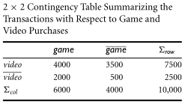
Lift: Example
Probability of purchasing game is P({game})=0.60
Probability of purchasing video is P({video})=0.75
Probability of purchasing both P({game,video})= 0.40
Apply lift formule
P({game, video})/(P({game})×P({video})) = 0.40/(0.60×0.75) = 0.89

Slide 45
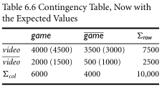
2. Correlation analysis using χ 2
Another correlation measure χ 2
To compute the χ 2 value.
Take the squared difference between the observed and expected value for a slot (A and B pair) in the confusion matrix, divided by the expected value.
This amount is summed for all slots of the confusion matrix.

Slide 46

Correlation analysis using χ 2
χ 2 Value is greater than 1, and the observed values (game, video) = 4000 less than expected value of 4500. This is consistent with the conclusion derived from the analysis of the lift measure in previous slides.

Slide 47
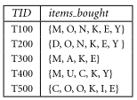
Assignment
A database has five transactions, Let min_sup=60% and min_conf=80%.
Find all frequent itemsets using Apriori and FP-growth, respectively. Compare the efficiency of the two mining processes.

Slide 48
References
http://www.slideshare.net/wanaezwani/apriori-and-eclat-algorithm-in-association-rule-mining
Chapter 6, Data Mining Concepts and Techniques, 3rd Edition written by Jiawei Han, Micheline Kamber and Jian Pei.

